Slide 1

Coursera Capstone: Where to open an Irish Pub in Brooklyn
Battle of the neighborhoods

Slide 2
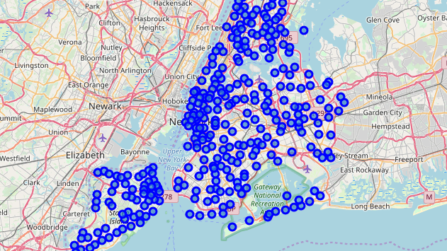
New York and Brooklyn neighborhoods
Step one – mapping the neighborhoods

Slide 3
Mapping New York
Folium map used with open data shapefile to map New York’s neighborhoods
 | Borough | Neighborhood | Latitude | Longitude
0 | Bronx | Wakefield | 40.894705 | -73.847201
1 | Bronx | Co-op City | 40.874294 | -73.829939
2 | Bronx | Eastchester | 40.887556 | -73.827806
3 | Bronx | Fieldston | 40.895437 | -73.905643
4 | Bronx | Riverdale | 40.890834 | -73.912585

Slide 4
Brooklyn neighborhoods
 | Borough | Neighborhood | Latitude | Longitude
0 | Brooklyn | Bay Ridge | 40.625801 | -74.030621
1 | Brooklyn | Bensonhurst | 40.611009 | -73.995180
2 | Brooklyn | Sunset Park | 40.645103 | -74.010316
3 | Brooklyn | Greenpoint | 40.730201 | -73.954241
4 | Brooklyn | Gravesend | 40.595260 | -73.973471
A subset was made from the NY dataset of just Brooklyn neighborhoods, also Folium mapped.

Slide 5
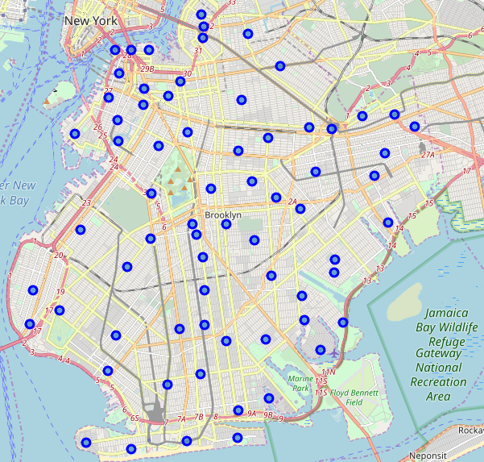
Brooklyn neighborhoods mapped for visualisation
map_brooklyn = folium.Map(location=[latitude, longitude], zoom_start=12)

Slide 6
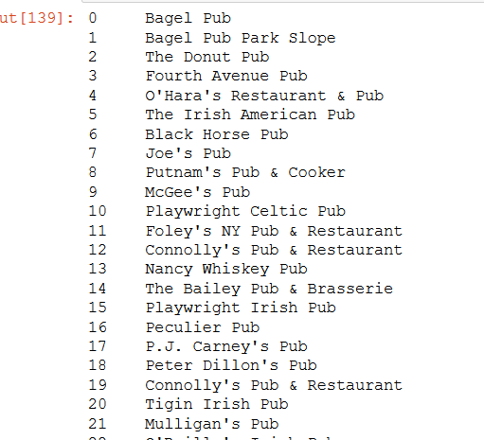
Irish pubs in brooklyn
Foursquare data used to find Irish pubs in Brooklyn

Slide 7
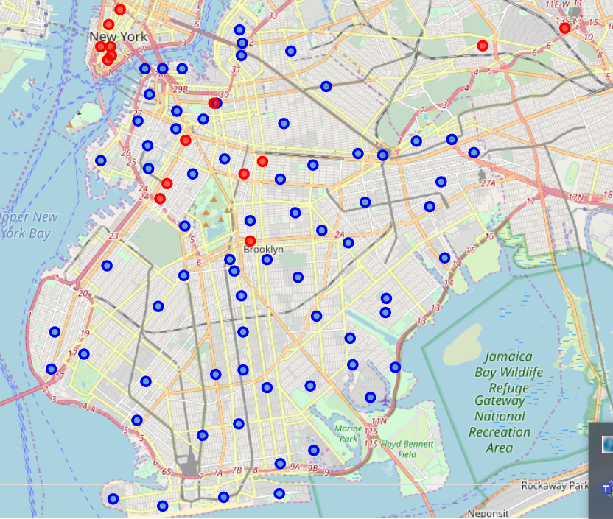
Mapping the Irish Pubs
Visualising the Irish pubs from Foursquare onto the folium map
Irish pubs are red dots
Neighborhoods are blue dots

Slide 8
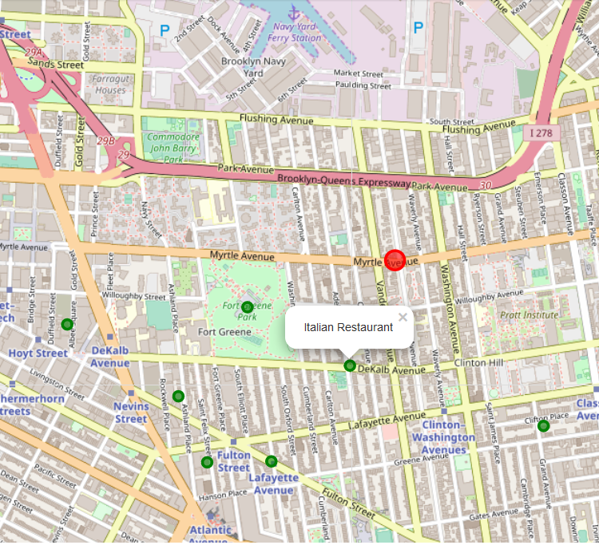
Examining the area around the Irish pubs – What are these areas like?
Examine what is in the same area as the Irish pubs
Are these busy areas? Trending?

Slide 9
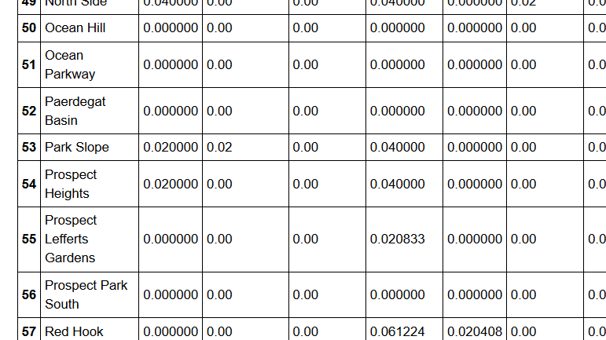
Getting the data ready for K-means
Grouping by venue, counts, one-hot encoding
Creates a dataframe ready to be used in k-means based on type and frequency of venue in each neighbourhood

Slide 10
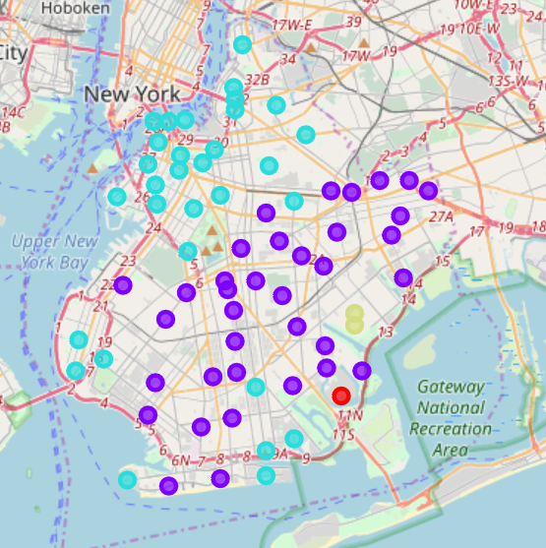
Brooklyn in five clusters
Clustering completed
Five distinct clusters
Clusters 0, 4 and 5 are outliers
Clusters 1 and 2 are largest
1 is central and residential (purple)
2 is closest to Manhattan and commercial/entertainment based (blue)

Slide 11
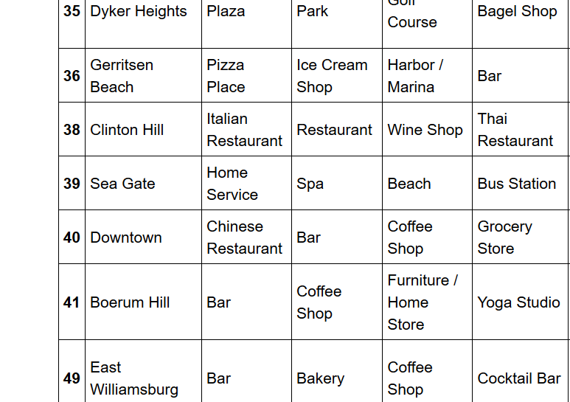
Conclusion
Boerum Hill and Clinton Hill are the two neighborhoods with Irish bars in cluster 2
Both have considerable nightlife/entertainment
These would be the selections to open an Irish pub

